Slide 1

Professional Selling

Slide 2
Overview
What is Professional Selling?
Overview of the Professional Selling Process
Different Forms of Selling
Evolution of Selling
Different Types of Selling In The Modern Era
Selling as a Profession
Why Become a Salesperson?
Selling Skills for Non-Selling People

Slide 3
Words to Watch
Sales
  the process by which people in one company help match the value of the products, services, and information their company offers to the needs of a targeted customers.
Sales calls
  face to face interactions between sales people and their customers (existing or potential) with the purpose that is geared toward the existing or future purchase of a product or service.
A professional
  One who acts in a manner that utilizes the best practices in a field to accomplish an objective related to an expected outcome.

Slide 4
What is Professional Selling?

Slide 5
Professional Selling
A career with freedom and _________,
  where you help people accomplish their _______
A common beginning career positions
A method for communicating
The top line of __________ for a company
An expensive way to promote a product!

Slide 6
Overview of the Professional Selling Process

Slide 7
Professional Selling Process
Four stage
Cyclical
Process
Takes place over time
Prepare
Learn
Evaluate
Communicate

Slide 8


Office
Work
Customer Facing

Slide 9
Prepare
  Understand company marketing strategy and goals
  Use a ________ approach to allocate resources
  Assess and prioritize opportunities with prospects

Slide 10
Learn
  Understand and build relationships
  Discover beliefs, goals, and needs of ________ accounts
  Analyze potential value and match to solutions

Slide 11
Communicate
  Communicate unique ___________
  Answer questions and overcome objections
  Obtain agreement and close

Slide 12
Evaluate
  Follow up to ensure ___________
  Observe industry dynamics
  Scan competition

Slide 13
Different Forms of Selling

Slide 14
Business to consumer | Business to business
Stocking | May be fewer customers
Organizing | May be larger dollar amounts
Merchandising | Specialized needs
Transactional selling | Longer term relationships
the purpose of the purchase (for personal use or business)
the risks associated with the purchase (high dollar or high uncertainty)
the attractiveness or ____________ with the purchase (unsought goods or new technologies), and
aspects of the relationship between buyer and seller (i.e. long term or designated as very important vs. short-term or unimportant).

Slide 15
Evolution of Selling

Slide 16
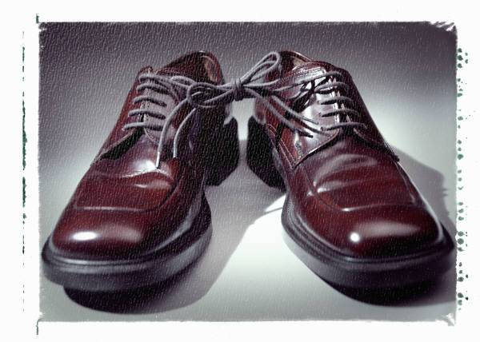


Changing Expectations
Sales Era
Product Era
Market Era
Company selects
Product options
Service levels
Delivery Speed
Competitor selects
Product options
Service levels
Delivery Speed
Customer selects
Product options
Service levels
Delivery Speed

Slide 17
Changing Customers
Customers
Price
Service and Information
Rackham and DeVincentis, 1999

Slide 18
Changing Customers
Customers
Need knowledge
Polarization
Price
Customers
Have knowledge
Service and Information
Rackham and DeVincentis, 1999

Slide 19
Evolution of Selling

Slide 20
Different Types of Selling In The Modern Era
Notes:
Figure 1.4 -- Individual "Buyers" Within Channel Levels
Selling to Small Businesses
Historically, purchase decisions in most industries shared aspects of both personal selling and business-to-business selling. As these industries grow the buying becomes more formalized and business-like, removing much of the personal selling aspect. But, there are still many business buyers for whom it is difficult to separate the business from the person making the decision.
This characteristic carries over into the sales process. The buyer may consider the salesperson to be a close friend, and the salesperson may spend much of his sales time in cultivating friendly relationships. However, in most industries this type of selling is no longer viable for small sales volumes. Professional salespeople today must spend more time evaluating the goals and needs of customers rather than merely being friendly. That’s not to say that personal relationships are no longer important. They are. But being friendly is no longer enough to justify a purchase in the minds of many buyers.
A unique aspect of rural businesses is the presence of small farming operations or hobby farms that are operated by people who are passionate about the rural lifestyle. Depending on the level of knowledge they possess, the salesperson’s role and the value they create may vary tremendously. Let us consider two examples. Feed salespeople in the northeast have reported that some horse feed customers are as well educated about feeds and nutrition as many of the experts in their suppliers’ operations. In a case like that it is challenging for a salesperson to exceed the customer’s knowledge. Much of the sales process with these highly knowledgeable customers is focused on technical issues in keeping their horses healthy. Contrast that with an equipment dealer who is selling to a part time farmer who has moved from the city and is just getting started with a small organic poultry operation. That type of farmer may rely on salespeople for much of the information they need to start their farm business.
As these two cases illustrate, salespeople play a variety of roles even within the same segment of potential buyers. The ability to approach different customers in a way that is needed by those customers requires a high level of competency from a professional salesperson.
Words to Watch: Personal Selling is selling to an end-user or consumer of a product or service.
Words to Watch: Business to Business Selling is when the sale of a product or service is for the purpose of use by another business in the production of value for a buyer further along in the channel that leads to the consumer or end-user.
Story Callout Box
Words to Watch: There may be several companies involved in adding value as goods move through the channel and movement is often influenced by outside parties – like technical specialists. Each step of movement through the system is known as a level.

Slide 21
Different Types of Selling
In The Modern Era
Personal Selling
Selling directly to the end user who will consume the product.
Sales and Customer Service -- Retail salespeople, clerks, and bankers
Dedicated Salespeople -- Appliances, Automobiles, Houses, Cemetery plots, Insurance, Investments
Business-to-Business Selling
Selling to businesses to help them increase efficiency, reduce expenses, or increase profits

Slide 22
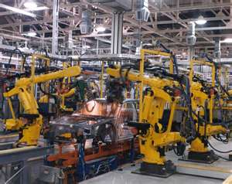
Selling at Different Levels
Manufacturing and Processing Companies
Wholesalers and Distributors
Retailers and Dealers
Influencers

Slide 23
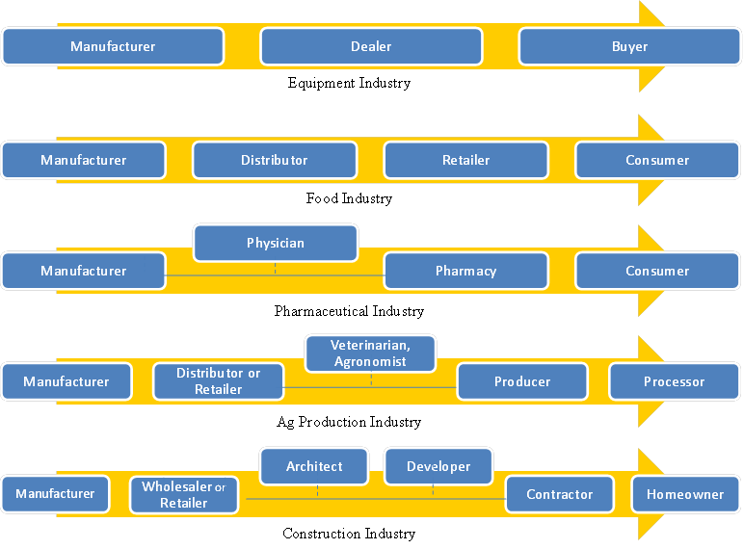
Industrial Channels

Slide 24
Multi-Level Accounts
Purchasing Manager
Salesperson
General Manager
Distributor
Sales Manager
Finance Manager
Regional Salespeople

Slide 25
Selling as a Profession

Slide 26

Profession
Webster: a "specific, identifiable craft for and about a specific group of people, products and services."

Slide 27
Sales Profession
Common
Language
Body of Knowledge
Code of Ethics
Set of Scientific Principles
Systematic Procedures

Slide 28
Competency
Knowledge, skills and attitudes
A measurable level of performance
Good knowledge of product features
Can translate product features to customer benefits
Assesses product "fit" and cost/benefit for each customer situation

Slide 29
Adding Value
Company’s support salespeople in their effort to bring ________ beyond products
Examples may include:
  Billing flexibility
  Troubleshooting difficult situations
  Product or pricing programs
  Special Services

Slide 30
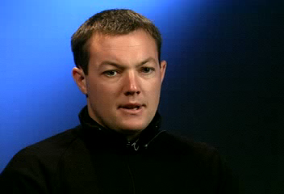
Sales People Add Value

Slide 31
Value through Salespeople
Intangible versus tangible value
Tangible value – easily measured, quantitative
Intangible – technical support, advice, prestige
Salespeople help their customers access ___________ to solve problems

Slide 32
Why Become a Salesperson?

Slide 33

Why Be a Salesperson?
Helping others
Freedom
Relationships
Rewards
  Compensation
  Location
  Knowledge Leaders and Creativity

Slide 34
Selling Skills for Non-Selling People

Slide 35
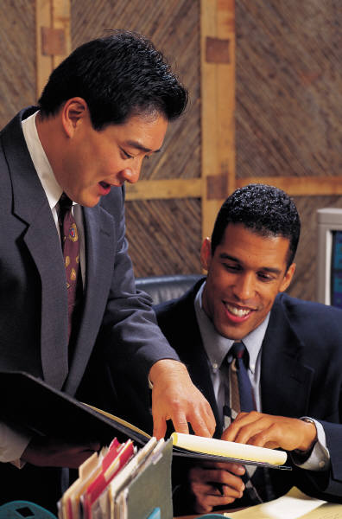
Selling Skills for Non-Sellers
effective communication
organized ways of thinking
understand complex human interactions.
communicate ideas to others
______________

Slide 36
Summary

Slide 37
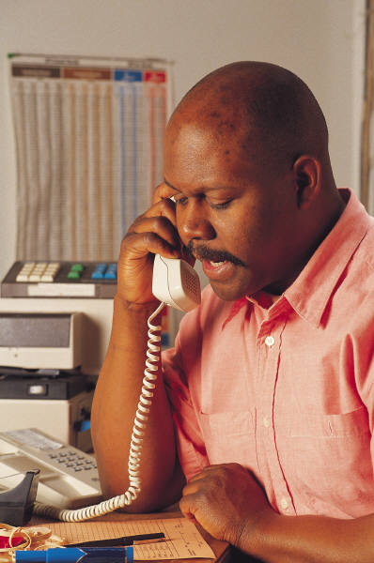
B2B Selling is a ________ process
  understanding the context and strategy of the company,
  understanding customers,
  selecting and communicating value,
  dealing with customer __________, and
  staying abreast of industry and competitive factors that affect the customer.

Slide 38

In different environments some parts of the sales process may take more time or may receive more attention than others.
Sales is a _____________.
Sales process varies depending on the level of the industry
But the skills of questioning, _________ and solving problems for each customer are important in every type of selling
And are helpful even for those not considering sales careers

