Slide 1
Preparing to Sell

Slide 2
Prospecting

Slide 3
Overview
What is Prospecting?
Prospecting Process
Tools
Multi-Level Accounts

Slide 4
Words to Watch
Prospect
Cold Call
Fear of Rejection
Lead
Referral
Trade Show
Field Day
Pre-Qualifying
PPI or Prospect Profile Index
Multi-Level Account

Slide 5
What is Prospecting

Slide 6
Prospecting
Someone you’re not doing business with today
New customers
Old customers
Or someone with whom you have a very small __________________

Slide 7
Why Prospect
Growth
Customer ____________
It’s natural for some customers to leave each year
They outgrow you
Their needs change
You mess up or they find an alternative
Consolidation

Slide 8
Prospecting Takes Motivation

Slide 9
Prospecting
Takes time
Not all opportunities are _________

Slide 10
Prospecting Process

Slide 11
Prospecting Process
Analyze Territory
Prioritize Prospects
Develop Profiles
Confirm Goals
Choose Methods
Analyze the Territory
What is the marketing strategy?
What segments exist
Which provide the prospects who are most likely to “fit” with the strategy

Slide 12
Prospecting Process
Analyze Territory
Prioritize Prospects
Develop Profiles
Confirm Goals
Choose Methods
Confirm Sales Goals
Market Penetration
Account Concentration
Confirm with leaders

Slide 13
Prospecting Process
Analyze Territory
Prioritize Prospects
Develop Profiles
Confirm Goals
Choose Methods
Choose Prospecting Methods
Cold Calls
Lack of Motivation
Fear of Rejection
Canvassing or Blitzing
Leads
From Customers, other professionals
Trades shows or field days

Slide 14
Field Days

Slide 15
Prospecting Process
Analyze Territory
Prioritize Prospects
Develop Profiles
Confirm Goals
Choose Methods
Qualify or Prequalify Candidates
Prioritize them by name
PPI

Slide 16
Prospecting Process
Analyze Territory
Prioritize Prospects
Develop Profiles
Confirm Goals
Choose Methods
Pertinent Information
History
Preferences
Beliefs, Goals and Needs
Updated

Slide 17
Tools

Slide 18
Prospect Priority Index (PPI)
Step 1. – Identify Criteria for high priority customers
Develop a list of the criteria that you consider to be important characteristics of valuable customers – that is, the ideal customer. These criteria may be demographic, behavioral, or attitudinal. Include as many criteria as you believe are important, but at least five. Weight
Criteria (10 = high)
_________________________________ __________
_________________________________ __________
_________________________________ __________
Step 2. – Weight Criteria
After you have developed a list of criteria, assign a “weight” or importance factor for each criteria (10 = high). While all criteria on your list are important (or they would not have been on your list) make certain that your weights accurately reflect the “relative” importance of each criteria.
Notes:
18

Slide 19
Prospect Priority Index (PPI)
Step 3 - Develop a Group Consensus of Criteria
Within your assigned groups, develop a consensus of criteria – with weights – that you all can live with. Be ready to report your group’s criteria and support your list.
Weight
Criteria (10 = high)
_________________________________ __________
_________________________________ __________
_________________________________ __________
Notes:
19

Slide 20
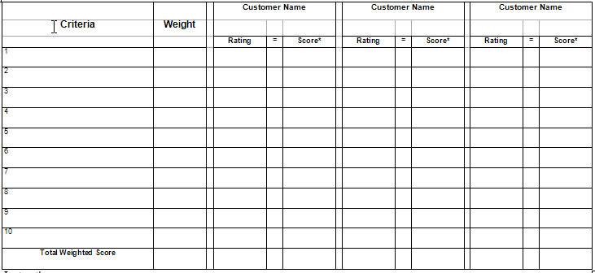
Prospect Priority Index Calculator
Step 4 - Copy your “desirability” factors into Calculator
Current Size
Growth Potential
Financial Stability
Management Ability
Influential
Notes:
20

Slide 21
Prospect Priority Index Calculator
Step 5 - Copy your “desirability” weights into Calculator
Current Size
10
Growth Potential
8
Financial Stability
9
Management Ability
9
Influential
6
Notes:
21

Slide 22
Prospect Priority Index Calculator
Step 6 - Enter your prospect names into Calculator
John Stout
Ralph Sands
Jerry Black
Current Size
10
Growth Potential
8
Financial Stability
9
Management Ability
9
Influential
6
Notes:
22

Slide 23
Prospect Priority Index Calculator
Step 7 - Score customer on first desirability factor – Accoss the page
John Stout
Ralph Sands
Jerry Black
Current Size
10
9
6
7
Growth Potential
8
Financial Stability
9
Management Ability
9
Influential
6
Notes:
23

Slide 24
Prospect Priority Index Calculator
Step 8 - Calculate the Score by multiplying the rating X weight
John Stout
Ralph Sands
Jerry Black
Current Size
10
9
90
6
60
7
70
Growth Potential
8
4
4
4
Financial Stability
9
10
10
10
Management Ability
9
8
8
8
Influential
6
9
9
9
Notes:
24

Slide 25
Prospect Priority Index Calculator
Step 9 - Add the Score for each customer to get the total weighted score
John Stout
Ralph Sands
Jerry Black
Current Size
10
9
90
6
60
7
70
Growth Potential
8
4
32
9
72
7
56
Financial Stability
9
10
90
7
63
6
54
Management Ability
9
8
72
9
81
9
81
Influential
6
9
54
4
24
10
60
338
300
321
RESULT - John Stout is the Highest Priority Prospect/Customer
Notes:
25

Slide 26
What does this mean?
The highest PPI score is
________________
Your top prospect based on
Your own criteria
your own weights
Where you should invest more time and resources

Slide 27
Target Priority Accounts

Slide 28
Multi-Level Accounts

Slide 29
Multi-Level Accounts
Very complex
Prospecting at multiple levels
Geographically dispersed
Several decision makers and decision influencers
Coordinate resources in a complex way
More formal
____________________
The salesperson acts as a team leader or manager

Slide 30
Multi-Level Accounts
Tips
Identify all the decision makers and influencers as soon as possible
Ask and keep a record of how success is _______________for each person
Know what the approval process is like for your products

Slide 31
Summary

Slide 32
Summary
Prospecting is a process
Helps a salesperson direct resources
Qualifying prospects saves time
Prioritizing process can be done using tools
Multi-level accounts are more complex and require more formal means to deal with them

