Slide 1
The Sales Process

Slide 2
Communicating Value

Slide 3
Overview
Value
Selling Points
Features, Advantages, and Benefits
The Total Value Proposition
Putting It All Together
Evidence
Competition

Slide 4
Words to Watch
Presentation
Value Proposition
Pitch
Selling Point
Total Value Proposition
Relative Value
Reduced Complexity
Features
Advantages
Benefits

Slide 5
Words to Watch
FAB Statements
Co-Created Value
Tangible Products
Field
Presentation Notebook
Benefit Tag Question
Objection
Evidence
Testimonial

Slide 6
There are Three Types of Value
Economic
Prices, discounts or programs
____________
Availability, reliability, control
Psychological
Status, peace of mind, security, risk
How much a customer values something depends on their
beliefs, goals, and needs
Notes:
6

Slide 7
Value
Value is communicated during the sales process through a “presentation”
During a first call, or after many calls
All of the activities up to this point in the sales process help to prepare for presenting value

Slide 8
Value
Preparation means understanding a customer’s
Beliefs
Goals
And Needs
And then SELECTING only those value points that are important to the customer, based on that understanding

Slide 9
Value
Preparation means understanding a customer’s
Communication Style
and
Buyer Type

Slide 10
Value
Preparation means identifying the selling points that will most appeal to that specific customer

Slide 11
What Do they Put a Price on?

Slide 12
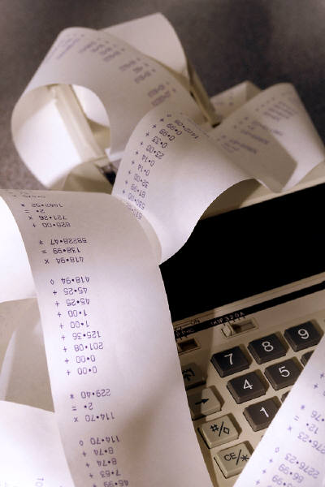
Managing Value
Perceived
Benefits
Perceived
Value =
Perceived
Costs
…If a customer doesn’t see it,
it might as well not have even
happened!

Slide 13
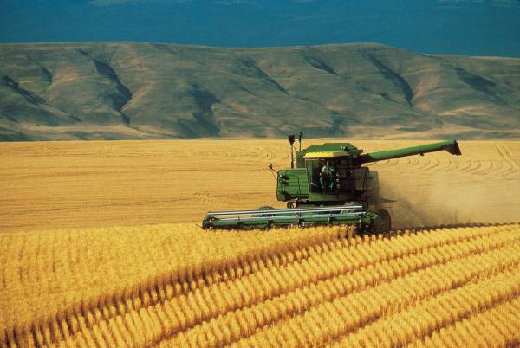
Selling Points
Selling points connect points you want your prospect to…
Know
Understand
Appreciate
About your…
Product
Company
Yourself

Slide 14
Perceived Value
Perceived
Benefits
Perceived
Value =
Perceived
Costs
There are really only two ways of helping a customer see the value!

Slide 15
Selling Points
Often, relationships between buyers and sellers are selling points
Dissatisfaction with current relationships can create a need for new ones
Reducing complexity or making things simpler can be a selling point today
There is a great deal of information that buyers have to sort through
Product capabilities often add complexity to processes

Slide 16
FAB Statements
Selling points are communicated in an organized way with FAB Statements
Features
Advantages
Benefits

Slide 17
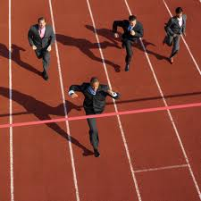
Features
Measurable facts about products
Attributes
Performance
Service
Delivery
Don’t assume that your customer sees the value of a list of product features!

Slide 18
Advantages
Advantages explain how a specific feature will “fit” the customer’s goals or needs
Often relative to other choices the customer may have
“Because this drug is injected subcutaneously, your patient will not have as much pain as other options that are injected intramuscularly.”

Slide 19
Benefits
A benefit is the ___________that comes from the feature
The need that is met
The problem that is solved
The goal that is accomplished
The good that will come to the prospect
The joy or financial gain that comes from having the product or service
Benefits explain why that “fit” is a good one

Slide 20
Benefits
The benefit is often stated as a __________ ________________:
“Fewer trips across the field will save you time and money.”
“You’ll be able to use those savings to hire that new employee you said was important.”
“Accessing records faster will leave you more time to spend with your family.”

Slide 21
Benefits
Ultimately, in business-to-business selling, benefits will lead to ____________________:
Save time
Save money
Make money
It is the salesperson’s job to relate the benefits to metrics that are used by the customer!!

Slide 22
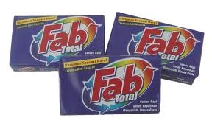
FAB Statements
FAB statements combine the features, advantages, and benefits into a logical sequence
That helps the customer clearly relate the products features to the things they care about.

Slide 23
FAB Statements
Because of… (Feature)
You will be able to… (Advantage)
Which means that… (Benefit)
_______________:
Customers don’t buy features, they buy benefits
Customers don’t naturally translate features into benefits on their own

Slide 24
FAB Statements
The same feature can have different benefits for different customers based on what’s important to them.
“More horsepower means you’ll be able to cover more ground, which saves you time.”
“More horsepower means you’ll be able to cover more ground, which will allow you to grow your business.”

Slide 25
FAB Statements
Beliefs
FAB Statements can sometimes connect to Beliefs, Goals, and Needs directly
Benefits
Goals
Advantages
Needs
Features

Slide 26
Through discovery, the salesperson hears the customer say:
So, the salesperson responds with:
Beliefs
And that will allow you to spend more time coaching Junior’s Little League
“Family is Important”
Benefits
Goals
“I’d like to be able to spend less time at the office”
That is one less thing to do each day, which saves you time
Advantages
Because our automated sweep transfers funds for you, you won’t have to come to the bank every day
Needs
“I need to automate some of my responsibilities”
Features

Slide 27
Value Is Created:
Through the product or service
Through the brand and reputation
Through ________________and customer service
Through the relationship with the salesperson

Slide 28
The Total Value Proposition
Personalized Services and Relationships
Support Program and Services
Brand and Reputation
Basic Productor
Service

Slide 29
The Total Value Proposition
The core products and services are important, but are sometimes difficult to differentiate
Brands and __________offer somewhat more differentiation
Support programs may be somewhat unique between suppliers and are sometimes more difficult to pull off
Personalized relationships cannot be duplicated

Slide 30
The Total Value Proposition
Professional sellers work to create value through each mechanism of the total value proposition
That takes time, but for the accounts that represent the best opportunities, it makes sense to invest time in creating a total value proposition

Slide 31
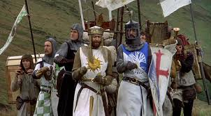
Putting it All Together
The presentation is a story
A beginning
A middle
An end
There is conflict and there is resolution
There is a _________________in which the hero (the salesperson) helps the customer see the light or comes riding in on a white horse

Slide 32
Involve the Customer
But, the presentation is interactive
It requires the customer’s involvement
The customer should continue to add to the conversation

Slide 33
Involve the Customer
An involved customer allows the salesperson to:
Be sure the customer is engaged in the decision
_________ whose problem is being solved
Uncover customer concerns as the conversation goes along rather than building up

Slide 34
Use Presentation Aids
“A picture is worth a thousand words”
- Arthur Brisbane
Presentation aids help tell the story
An Agenda
______________
Be careful here – Poor conditions, failure, distractions are common
Binders or notebooks
Customized for the customer

Slide 35
Presentation Aids

Slide 36
Putting it All Together
Five basic parts to the “story”
Confirm needs
Ask for information
Offer alternatives
Develop selling points
Confirm understanding and acceptance

Slide 37
Confirm Needs
It is very important to begin with this step
Time may have passed and needs ____________
You don’t want to sell a solution for the wrong problem
It reminds the customer what the problem is that you’re solving

Slide 38
Ask for Additional Information
Asking for additional information
Let’s the customer know you’re not just interested in the solution, but interested in them
Sometimes allows you to discover critical information that wasn’t discussed previously

Slide 39
Offer Alternatives
Providing a _________
Keeps the salesperson from appearing to “push” a single solution
Allows the customer to spend more on deluxe model
Helps the customer understand trade-offs
Plants the seed for future purchases

Slide 40
Offer Alternatives
Providing a choice
Risks _______________ the customer
Potentially confuses the benefits they’ll receive from one model with benefits of others
Can waste the time of a “high D”

Slide 41
Present Features, Advantages and Benefits
This is where you help your customer see how your solution benefits them
Probably the most significant aspect of the presentation

Slide 42
Confirm Understanding
If the customer doesn’t understand the solution,
Or agree that it’s the right one
Then you might as well not have presented it at all

Slide 43
Confirm Understanding
Secure agreement that you’ve chosen the right solutions with a “benefit tag” question
The benefit tag doesn’t ask if they will agree to buy, but confirms that the benefit you presented is important to them
And seeks their agreement that the features will lead to benefits they care about

Slide 44
Benefit Tag
“And you said spending time with your family was important to you, right?”
“So do my figures add up to the savings you were hoping to achieve?”
Does that make sense to you?

Slide 45
Evidence
Even if you’ve developed a high degree of trust, the customer knows that you represent a different company than their own
They may not believe that
The product can do what you say it can
That service will be as promised
That the features described will lead to the benefits you claim

Slide 46
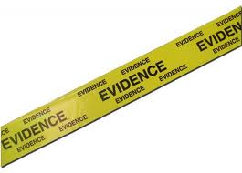
Evidence
A salesperson must plan ahead for these potential areas of disbelief by providing evidence.
Third party evidence is best
Customized evidence for a specific customer also works well

Slide 47
Evidence
There are many types of evidence
Testimonials
Tailored calculations of costs and benefits
Controlled trials
Demonstrations
Samples
Photographs and videos

Slide 48
Testimonials
Testimonials are the experiences of other customers
. . . their testimony “proves” your value
If you use a testimonial . . .
Make sure that you have ____________
Make sure that this person is a “respected”
Never divulge any confidential information

Slide 49
Testimonials
Tell customers how much success a competitor has been having with a product and tell them that you want to try the same idea in their stores.
Tim - Hormel

Slide 50
Calculations - Cost/Benefit Analysis
Commercial customers increasingly want to know what a new product or service will do “for them” in hard ____________
Show a prepared worksheet giving typical results for your area
Prepare a spreadsheet with several options and their costs and results
Prepare a “blank” worksheet and walk through it with the customer allowing them to enter their own information

Slide 51
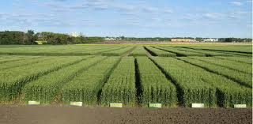
Demonstration Trials
Trials may be completed in a “typical” operation and then written up and published.
Some of these trials may be provided by your company.
It is common and highly effective for the local sales rep to establish some of these trials,__________to local conditions

Slide 52
On-Farm/In-Business Trials
These trials are the _____________to convince customers of a product’s benefit
Trials are offered to the customer to make sure that the evidence is fair and objective.
The customer may also be given ________to make sure that all other production parameters are the same for both groups, and the performance of your product can be fairly “isolated” from other variables

Slide 53
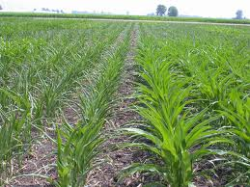
On-Farm/In-Business Trials
The “trial” may consist of a specified sample use period, followed by an _____________ involving both the salesperson and the customer
Usually product that is “on trial” in a business is offered to the customer at a sharply reduced cost or at no cost

Slide 54
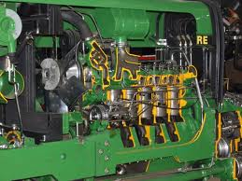
Photographs
Photographs . . . and _________________ sales presentations, allow the customer to see and judge a product’s performance.
There is a role for photographs for many products …a picture still speaks a thousand words

Slide 55
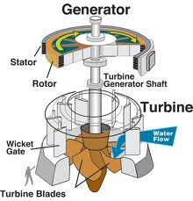
Photographs
Photographs and computer-based presentations are particularly useful in situations . . .
Setting product performance expectations
Showing product features
Demonstrating product mode of action

Slide 56
Competition
Be careful about challenging loyalties with competitors
Never make disparaging remarks about a competitor
Highlight your selling points
Don’t deny advantages you have, just speak positively about them

Slide 57
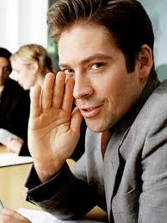
Competition
Know your competition
What are they good at, bad at?
Know prices and value offerings in your market area
Be prepared to address differences in a positive way by emphasizing your total value proposition
Never badmouth a competitor

